Slide 1

LEARN TO SPEAK IGBO LANGUAGE
MỤTA Ị SỤ ASỤSỤ IGBO
AHỤ IKE
Health and Physical Wellbeing
AB WEEK 2:2

Slide 2
Uru-
Function:
- practice how to express your well-being.

Slide 3
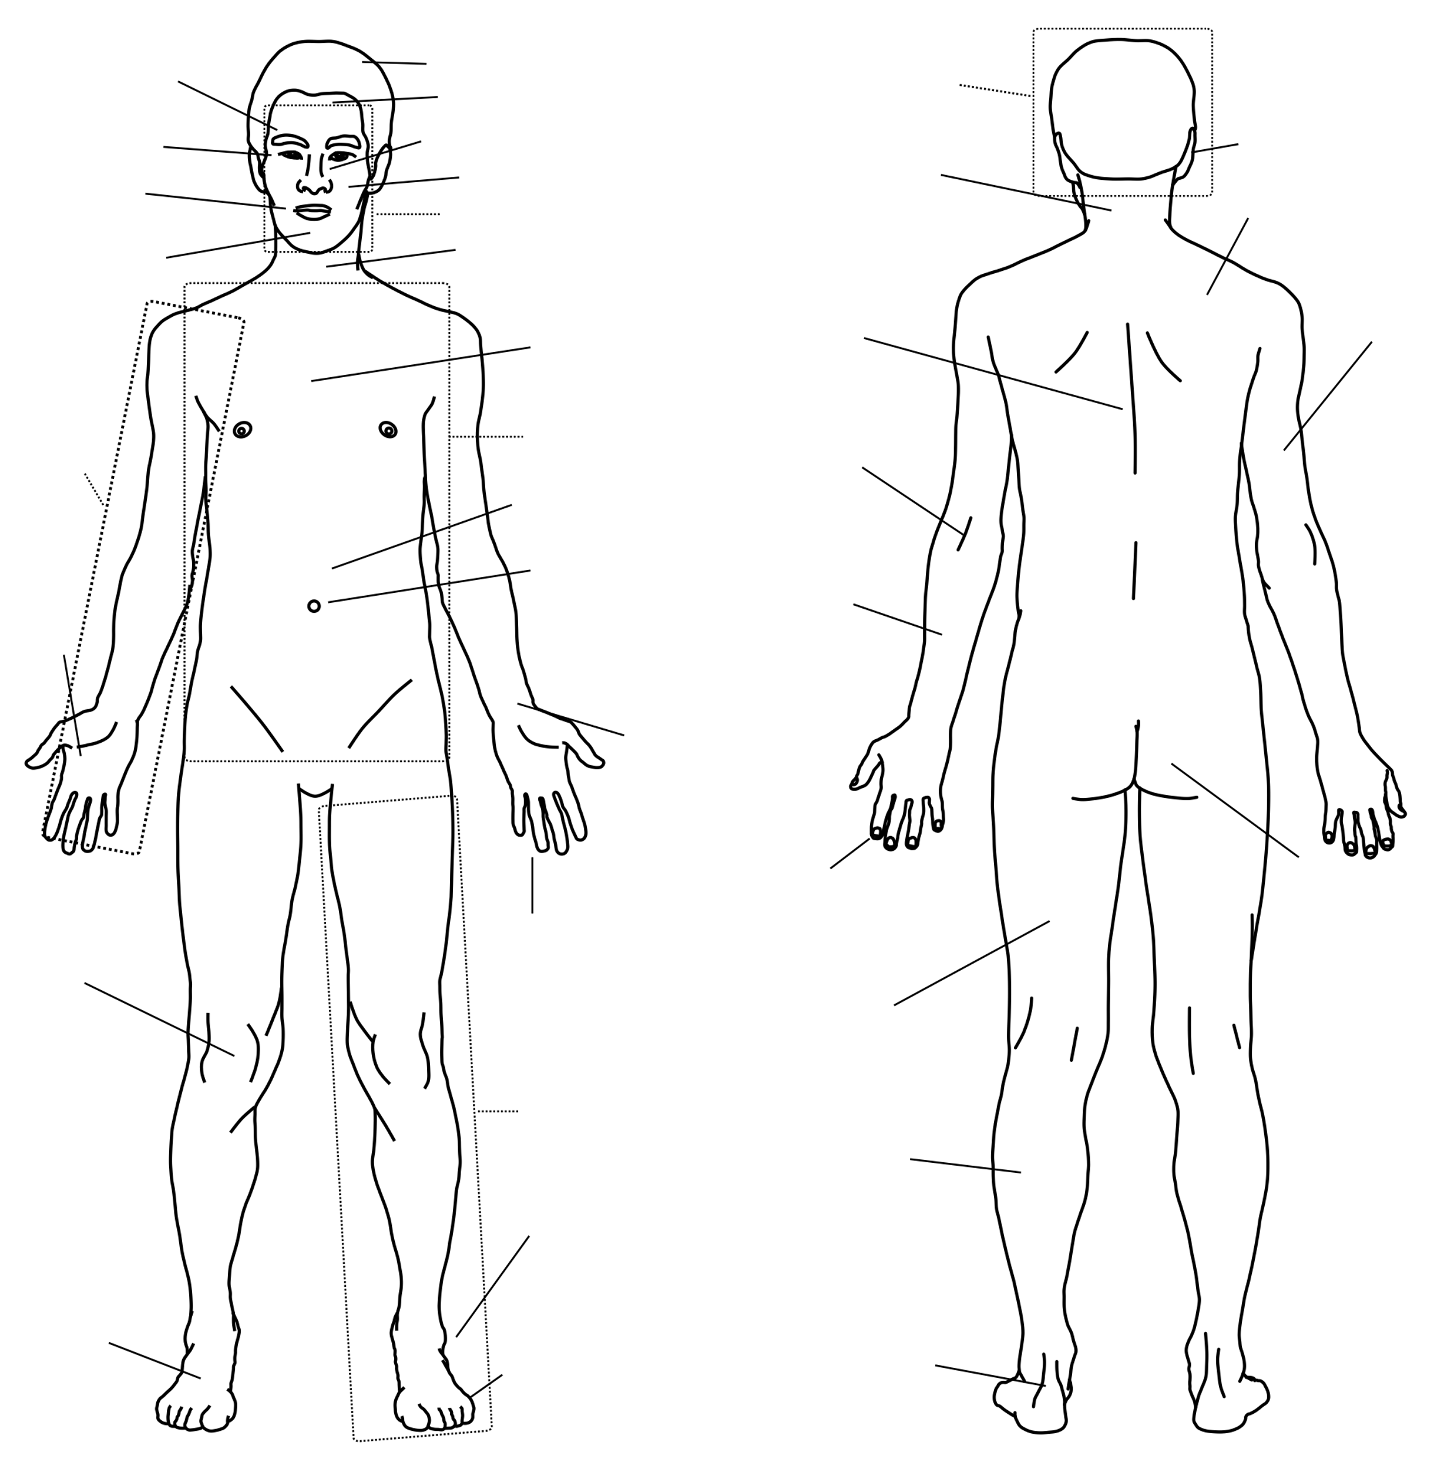
ÀHỤ IKE
Sketch: Šlomo, CC0, via Wikimedia Commons

Slide 4

Terms
Agụụ Hunger
Ọrịa illness
Àhú ike Good health
Ụfụ Pain/ Irritation
Ọkọ Itch

Slide 5
Ọnyá Sore
Ọnyá Akpịrị Sore throat
Anya mgbu Eye pain
Nti mgbu Ear pain

Slide 6
Isi ọwụwa Headach
Íké ọgwụgwụ Fatigue/Tireness
Ahụ Mgbu Body pain/ body ache
Úkwu mgbu Waist pain
Azụ Mgbu Back pain

Slide 7
Afọ ọrụrụ Belly ache
Afọ ọsịsa Diarrhoea
Ajụ Dizziness
Agbọ Nausea
Óyi Cold

Slide 8
Ịba Fever
Ótuto Boil
Ọbara blood
Ụkwara Cough
Azụzụ Flu

Slide 9
Ada batara n’ulọ na-eme ike ‘ọgwụgwụ ike ọgwụgwụ, ‘ nne ya wee jụọ ya; “Ada, gịnị na-eme gị?”
Ada wee zaa nne ya:

Slide 10
Sample Expressions
Agụụ na-agụ m I am hungry
Nne, ọ dị ka a chọrọ m ị da ọrịa Mother, its seems i am falling ill.
Àhú siri m ike I feel well. I feel strong
Àhú esirghị m ike I dont feel well
Àhú a dighị m I am ill.
Anya na-afụ m ụfụ My eyes hurt

Slide 11
Ọkọ na-akọ m n’azụ My back itch
Ahụm niile na-akọ m ọkọ My whole body itch
Ọnyá dị m n’ụkwụ na-afụ m ezigbo ụfụ The sore on my leg really hurts m.
E nwere m Ọnyá Akpịrị I have Sore throat
Ụkwara na-akwa m I have cough
E nwere m azụzụ I have flu
E nwere m isi ọwụwa I have a headach/ My head aches

Slide 12
Isi na-awa m I have headach
Íké gwụrụ m I am tired
Ahụ na- egbu m mgbu My body aches
Úkwu na-egbu m mgbu I have waist pain
Azụ na-egbu m mgbu My back aches
E nwere m anya mgbu I have eye pain
Nti na-egbu m mgbu My ear hurts
Afọ na-arụ m I have stomach ache

Slide 13
Afọ na-asa m I have iarrhoea
Ajụ na-ebe m I fee dizzy
Ọ na-eme m agbọ I feel nausea
Óyi na-atụ m I feel cold
O nwere ịba He/she has fever
Ótuto toro ya n’ike He/she has boil on her buttocks
Ọbara na-agba ya n’ụkwụ She/He is bleeding on the leg.

Slide 14
Ajụjụ maka ahụ ike
Gịnị na-eme gị?
Isi ọ na-awa gị?
___
Ndo Sorry
Ka anyị gaa ụlọọgwụ Let’s go to the hospital.
Ị ṅụgo ọgwụ gị Have you taken your medication?

